Slide 1
Algo Trading
Pierre-Yves Guillo – instructor
Alex Marchi – TA
alexander.marchi@nyu.edu

Slide 2
The Deal!
You participate
Hands on
And everything will be fine
Allocation of points
Class participation – 15
Weekly quizzes – 6x5 – you can miss one w/ proper excuse (sickness, interviewing far away,...)
Assignment(s) – 15
Project(s) – 2x30
You will be CURVED....
Total is 120!! That is a great deal – up to you to uphold it

Slide 3
Electronic markets
Two broad types of market:
Centralized and organized
Existence of a central clearing entity
Anonymous
Price dynamic-related regulations (Sell Only on an Up-tick, Circuit Breakers,...)
Examples are Future Exchanges, Stock Markets, ECN’s
Over the Counter
One-to-One transaction
Ad-hoc credit agreements
Examples: FX Cash, FX Options

Slide 4
Market participants – Market Makers
A Maker
An entity willing to show Bid and Offer prices for a minimum of size at all times ( or most of the times)
Has obligation to maintain a liquid market – i.e. show Bid and Offer prices at all times for a minimum size
It could be a Bank, a Broker, a “registered” individual (w/ capital)
Think of the “bank” or “dealer” at our favorite casino
She is providing the game and the “clients” play against the house
Terms used – Broker, Dealer, Specialist..... All make a market – they establish a market and keep it going

Slide 5
Market Makers
Makers are done (i.e. executed) on their side
They sell at the Offer price (high)
They buy at the Bid price (low)
A Maker earns the bid/offer spread
They have an inventory to manage – they do not want to be (very) long or (very) short for any period of times as they do not have an actual/real need for this risk – they are neither hedgers nor speculators

Slide 6
Market participants – Market Takers
A Taker – an client
A Taker needs a market so she can trade at all times
A Taker benefits of the availability of a healthy market
It could be a corporation, a pension fund, a “qualified” individual (w/ some capital), an insurance, a manufacturer, a financial institution, an hedge fund, a Central Bank
Think of the “player” or “client” at a casino
The “clients” of a casino enjoy the presence of a “table” and an organized game, and play (some time) against the House
Terms used – Client, Speculator, Hedger,..... All take the market – they benefit from the presence of an established market today and tomorrow so that they can fulfill their transactional needs (to acquire or give up exposure/risk)

Slide 7
Market Takers
Takers cross the market to get done (i.e. executed)
They buy at the Offer price (high)
They sell at the Bid price (low)
A Taker pays away the bid/offer spread – actually half the b/o spread
They have an economic activity to manage – they have assets and liabilities to balance
Or they want to be exposed to risk (market moves)
They will hold the acquired position for some period of time (from a few milli-seconds to a few decades)

Slide 8
How a market is quoted
At minimum, two prices, bid & offer, and two sizes, again bid & offer
There maybe several levels – i.e. several bid prices (lower and lower prices) and several offer prices (higher and higher prices)
Usually the sizes available at these different price levels are larger the lower a bid is (resp. the higher an offer is)
A rough measure of liquidity is the size of the spread (offer minus bid) for a given size
Note that your credit worthiness will impact the liquidity available to you

Slide 9
Ticks, Pips and Bips
Each market has its own conventions in regard to how a price is quoted and how a size is represented

Slide 10
Ticks, Pips and Bips.... Futures
In a Futures market – the Tick terminology is used
A contract represents a defined quantity of the asset traded and therefore the tick (which is the smallest amount by which a price can change) is worth a defined number of dollars (or units of the ccy used to buy or sell the asset offered as a futures)
Be Aware of the defintion of the physical asset underlying the traded futures contract and its delivery mechanism

Slide 11
Ticks, Pips and Bips.... Foreign Exchange
In the world of FX, one buys or sells an amount of base ccy (rarely less than 100 k, usually in increment of 100 k, typically one or a few millions)
When transacting FX’s, one buys/sells the base ccy and pays/receives the executed price in the counter ccy.
buying 1 mm gbpjpy @ 142.15 – you receive, in two days, 1 mm gbp and pay away 142.15 mm jpy
a pip is xxx.x1 in this case

Slide 12
Ticks, Pips and Bips.... Stock Markets
On a stock market, one buys or sells a given number of lots of shares in the corporation of interest. One has to know how many shares is a lot.

Slide 13
Types of Orders
An order is “placed”
Then this “order maybe executed”
This becomes a trade -- a trade is, by definition, executed!

Slide 14
Types of Orders....
Many types -- two are key:
Market Orders
Limit Orders
A market order is to buy/sell at the then prevailing (which may be quite far from what you have in mind) price a certain amount of the asset referred – this is risky
A limit order is to buy/sell at the specified price (and not worse) a certain amount of the asset referred – you may not be done

Slide 15
Types of Orders....
A marketable limit order is a limit order which is likely to be executed upon its arrival as its limit is slightly worse than the market
Note that you need to specify a time until which your limit order is valid otherwise it can remain “open” forever(?) and get filled at a time when you totally forgot about it – you need to manage your limit orders!
An algo trader uses only limit orders (and most of the time w/ none or very short time limit) as an algo placing orders should know where the market is at that instant and for the given size of the order (and for your credit)

Slide 16
Market Regimes – Characteristics
The market moves from the joint effect of endogenous and exogenous information

Slide 17
Market Regimes... Characteristics
Endogenous – information coming thru the market observed as changes in the flow. A new participant, for instance, desiring purchasing a large quantity of the underlying asset

Slide 18
Market Regimes... Characteristics
Exogenous – information coming to the market due to the happening of an event (terrorist attack, natural catastrophy, release of an unexpected economic number, result of an election). In all cases, the event is unexpected in its manifestation.

Slide 19
Market Regimes... Characteristics
Note that liquidity upon stress can be greatly reduced and even disappear for a period to time
Reduced liquidity means a wider bit/offer spread and/or smaller quantities offered or no market at all
<<here includ study on Gbp/Usd fastcrash>>

Slide 20
Market Regimes – Observed
Three broad regimes are observed
Mean Reversion
Break Out
Trend/Dislocation
As always there is an issue of scale – what is a big move?

Slide 21
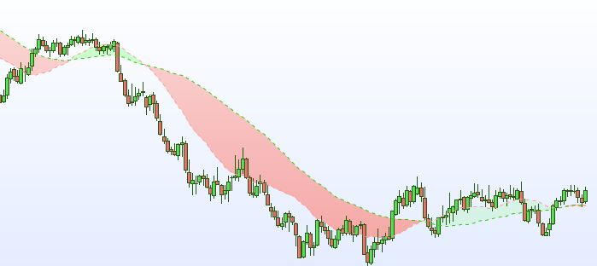
Aud Trend/Dislocation weekly

Slide 22
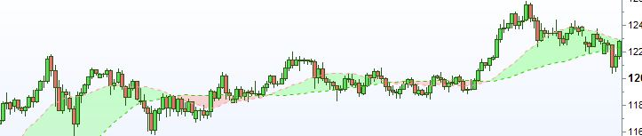
Jpy MR daily

Slide 23
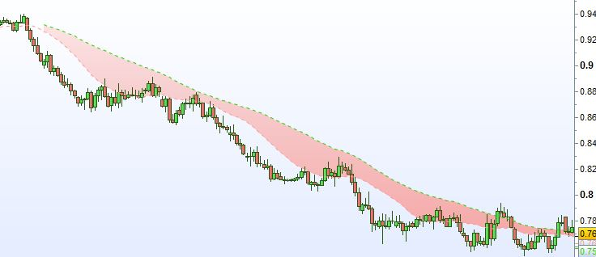
Aud Trend Dislocation daily Aug-Apr15

Slide 24
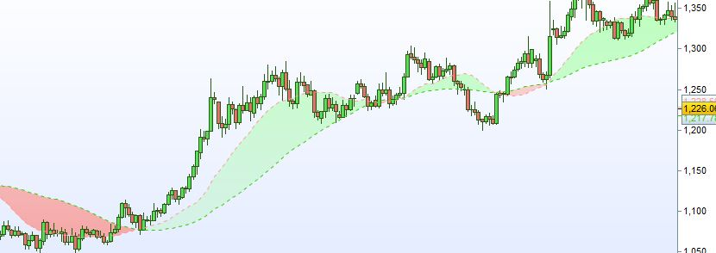
Gold MR BO & Trend daily Dec-Aug16

Slide 25
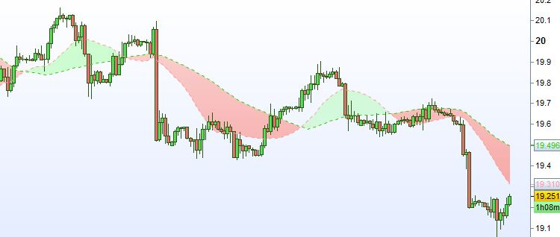
Mxn MR BO 2-hour Mar17

Slide 26
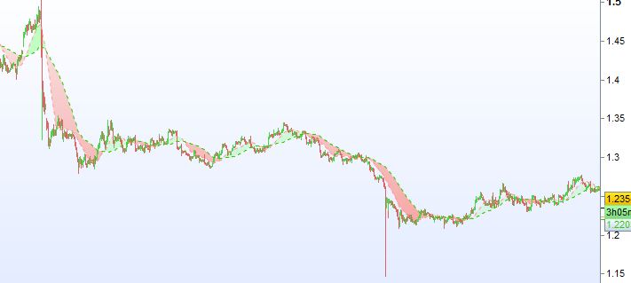
Gbp Dislocation Jun-Dec16

Slide 27
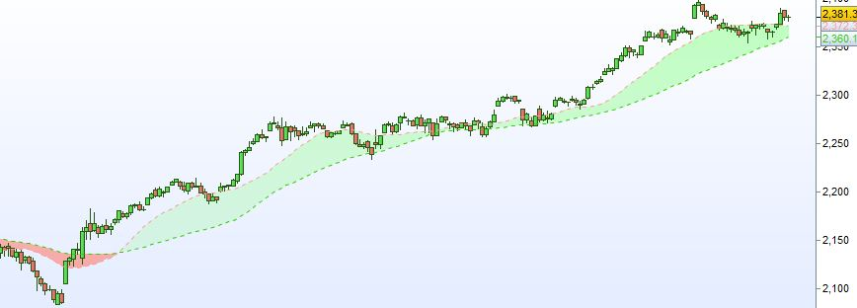
S&P MR, Trend and BO Nov-Mar17

Slide 28
Market Regimes... Observed
A good way to measure a move is to measure it in terms of number of Bid/Offer spread
Indeed a market taker paying half the spread to get in position and paying again half the spread in closing her position needs to see (or expects) the market moving by a number of bid/offer spreads in order to make money
Therefore she has to stay in the market long enough for the market to possibly move by the targetted amount

Slide 29
Mean-Reversion (MR)
Characteristic of a market w/o new major information, i.e. directionless
As (slightly) larger orders are to be filled the market moves away to come back
Volatility is small and High-Low (HL) daily range small

Slide 30
Mean-Reversion (MR) ...
You should be short gamma at this stage
Or selling the small up move and buying the small down move
Expect earning 5-10 b/o spreads at most
Small frequent gains
You need therefore to leverage yourself
Risk is to see the market continuing its move and you to lose N years worth of PnL
Volume and participation remain about balanced

Slide 31
Break-Out (BO)
An large order may have to be filled
Imbalance in the volume traded appears
Price moving out of the past few period ranges

Slide 32
Break-Out (BO) ...
A nascent price move sets in
On the upside, previous sellers are now under water and start to bail out fueling the rallying move
Volume imbalance is a tell-tell sign
Expect a move of 20-40 b/o spreads
The PnL profile of a strategy based on Break Outs is many small PnL loses (think of MR) w/ one large gain from time to time as the market breaks out

Slide 33
Dislocation or Trend
Exogenous information arrived in the market
Stops are taken out
Weaks positions are also taken out
A new market range will eventually get established
From the moment a trend is unfolding – a few hundred’s if not thousand’s of b/o spreads are at stake
Late comers join the move to extend it
It will eventually correct back some to then settle into a new MR dynamic

Slide 34
Dislocation or Trend....
The risk of a dislocation or trend is that you are late to get in and late to get out
Your PnL expectation is then curtailed
Furthermore, if you “average” getting in your entry point is getting worse and worse, and you risk to cross your soon exit price raking up a loss...
Danger of entering in stages
One needs to have “conviction” (to be defined) to commit close to her allocated capital for that strat

Slide 35
Stats for a trading strategy
Daily returns – or hourly returns – (weekly/) monthy returns are too far apart (good to have as a recap)
Graph of cumulative daily returns
Computed yearly returns – at least calendar yearly periods – you may also be interested in a sliding yearly period
Annualized volatility of your daily returns (or hourly or monthly) returns
Compute your very important Information Ratio (which is Return/Vol)
What is the difference between the Information Ratio and the Sharpe Ratio?

Slide 36
Stats....
Sharpe Ratio is (Return – YourFinancingRate)/Vol
You need to assess the risk you are taking – the proverbial tap-on-the-shoulder.
Your top 3 to 5 largest DrawDowns since inception is a critical measure of risk
The current drawdown is the cumulative (negative) PnL since your last high
A good ratio is yearly perf/ divided by largest DD

Slide 37
Stats....
Other interesting measures for DD’s:
Time to reach lowest point (drough)
Time to recover from drough
Other other stats:
What happened when you remove the 10 top gaining days? Are you still making money
% winners, % losers
Median dayly pnl, Average daily pnl
Are you correlated to S&P? to Gold? to 10 Year yield
Are you making money on NFP, Fed, CPI annoucements

Slide 38
Stats....
What is your concentration per asset?
What is your leverage?
Ah also! Are you “capital efficient”? What is your return on your average daily margin?

